Slide 1
GoLearn
An online teaching resources application for students and teachers

Slide 2
What is GoLearn
GoLearn will be a web application that will be used by teachers and students to access learning resources to be used alongside their studies
Teachers can group content into sections and units for their students to access when they need it
Students get a limited view of the classes that they are enrolled on, and can view the content that is open for students within those classes

Slide 3
How does GoLearn work?
GoLearn will allow administrators to register Teachers and Students and manage all the content and users on the system.
GoLearn admin will also be able to set up classes and enrol students.
Teachers can then log in and set up the content on their classes in various ways to allow their students the best experience possible.
Students can log in and view all the classes that they are enrolled on and access the resources created.

Slide 4




Similar Services
Udemy
SkillShare
LearnDash
Moodle

Slide 5
Udemy
Udemy is an online teaching platform that is free to use
Teachers create content, list it for a price (can be Free)
They get an intuitive UI to create their content, and not too many options
Students pay to unlock the content, and get it for life
The UI for students is very clean and simple to use, leading to good UX

Slide 6
SkillShare
A subscription service to access all learning materials on the platform
Teachers need to register for the service and have all courses reviewed before they go live
Students pay a set amount for access to everything that has been authenticated by SkillShare
Experience is similar to Udemy, with the key difference being the business model it is built on

Slide 7
LearnDash
LearnDash is an application that allows a high level of customisation to courses, and is an application that can be either installed onto a server or as a plugin on a WordPress site. (The UI and UX are similar)
Teachers create content in a highly customisable setting
Students can be assigned to the courses and access it with a very nice UI, leading to very good UX.

Slide 8
Moodle
Most similar to what I intend GoLearn to be, and is a heavy influencer on decisions I make, and is a full LMS application
Teachers create content for Modules/Courses, with students being assigned to those courses.
Students can only access open courses and those that they have been enrolled on.
UI and UX are heavily customisable via plugins and themes

Slide 9
Technologies
LAMP, LEMP – PHP Stacks for static content generated on the server
MEAN, MERN and MEVN – JS Stacks using MongoDB, NodeJS, ExpressJS and a front-end framework
Full stack JS frameworks – Next, Nuxt

Slide 10
Full Stack JS Frameworks
Use JS to manage and fulfil HTTP requests.
Next and Nuxt both provide a routing mechanism that the developer doesn’t have to interact with short of naming their files and directories following a pattern/naming convention
Use a variety of libraries to manage data and CRUD operations (such as Apollo for GraphQL queries and Prisma for data management)

Slide 11
Project Outcomes (minimum requirements)
Design and implement a suitable data structure for storing related information
Design and implement an API to allow CRUD actions to be performed to store data in the implemented data structure
Design and Implement an Admin interface to perform CRUD activities on Users and all content
Design and Implement a Teacher's interface to perform CRUD activities on their resources
Design and Implement a Student's interface to view allowed content on teacher generated resources

Slide 12
Project Outcomes (extras)
Design and Implement an Teacher interface for performing CRUD interactions on Assignments
Design and Implement a Student's interface to interact with the teacher created assignments
Design and Implement method of submitting assignment work for Students
Design and Implement method of responding to assignment submissions for Teachers
Design and Implement communication channels for classes and/or teachers

Slide 13
Technical Achievements
First draft of background research and project objectives
Risk Assessment
Set up an empty Next.js application in a docker environment for developing application
Started creating tasks to complete on Jira (some being already complete)

Slide 14
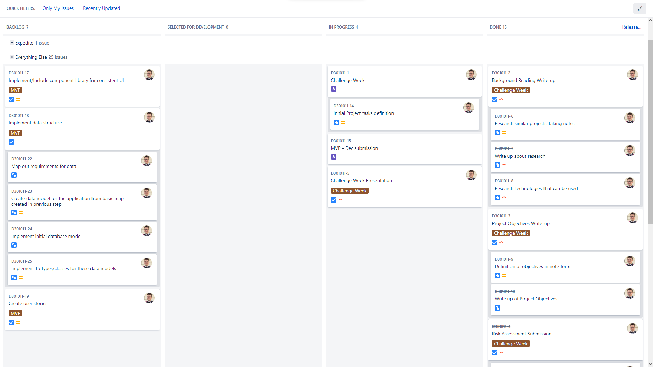
Go Back

Slide 15
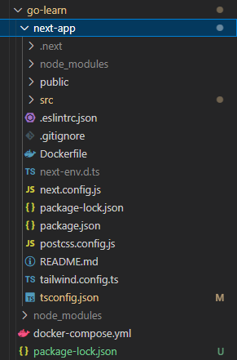
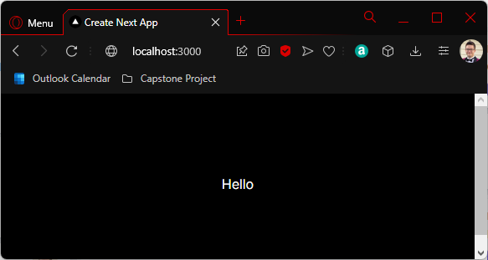
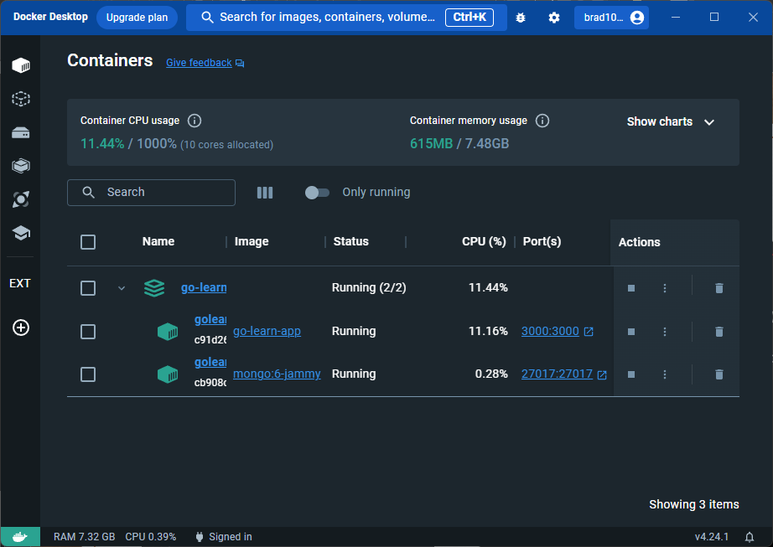
Go Back

Slide 16
Use of Project Management tools (JIRA)
Use Epics to highlight milestones (key objectives met)
Stories to define interactions or desired features being implemented
Tasks as Standalone requirements that do not have a specific story that they belong to.
Sub-tasks on Stories and Tasks to break up the issue into manageable chunks
Bug to highlight found bugs when reviewing the progress made at the end of each story, task and epic
Supervisor feedback when I have a query for my supervisor to comment on

